Slide 1

HTML Tags
Gayathri Appannagari

Slide 2
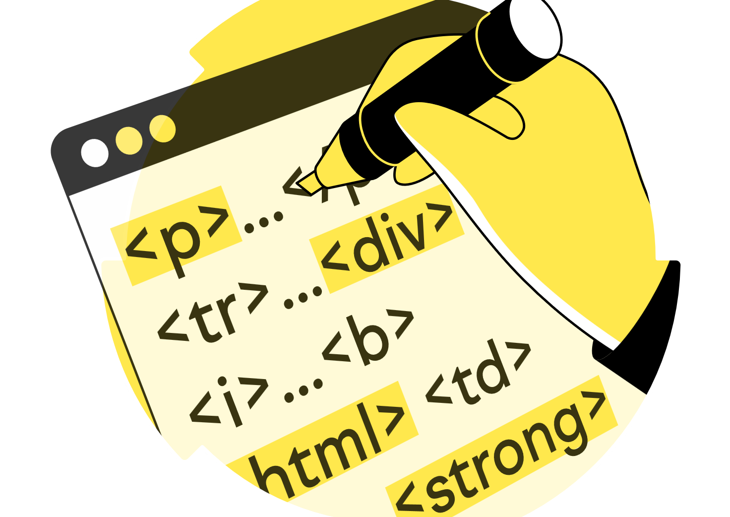
Agenda
What are HTML Tags?
List of tags
Types of HTML Tags

Slide 3
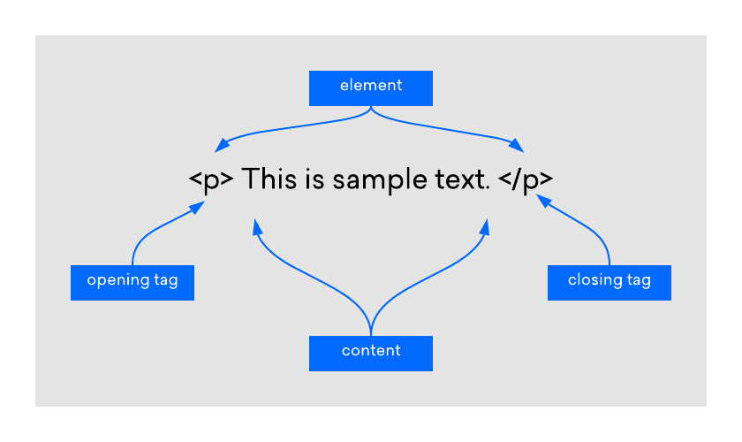
Introduction
HTML tags are essential building blocks that define the structure and content of a webpage.
HTML tags are composed of an opening tag, content and a closing tag.
The opening tag marks the beginning of an element, and the closing tag marks the end. In-between the opening and closing tags content falls.

Slide 4
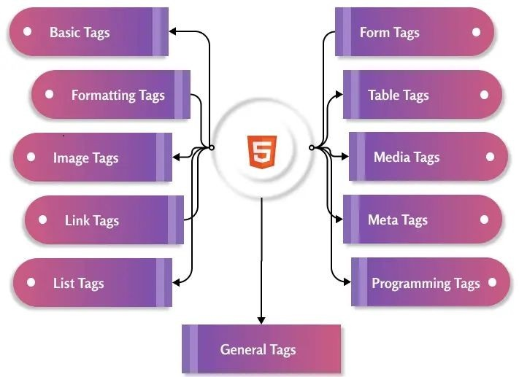
List of tags

Slide 5
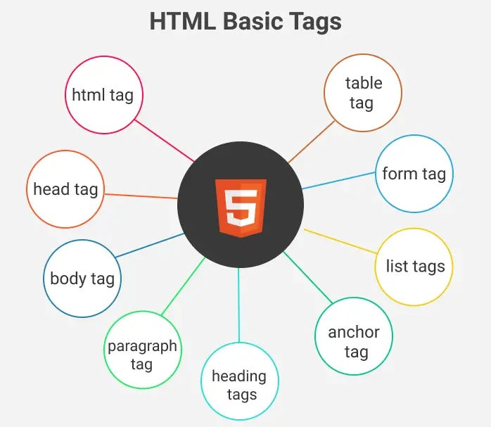

Slide 6
<!DOCTYPE html> <html> <head> <title>Title of a document</title> </head> <body> <h1>This is heading 1</h1> <h2>This is heading 2</h2> <h3>This is heading 3</h3> <p>Here is a first paragraph of text.</p> <p> Hello <br /> You are on time.<br /> Thanks<br /> Mahnaz </p> <p>This text is not in the center.</p> <center> <p>This text is in the center.</p> </center> <p> This is paragraph one and should be on top </p> <hr /> <p> This is paragraph two and should be at bottom </p> <pre> This text is pre-formatted. </pre>
<p>
An example of this technique appears
in the movie "12&nbsp;&nbsp;&nbsp;&nbsp;Angry
Men."
</p>
<a href=“www.google.com /”> Google</a>
<ul>
<li>Banana</li>
<li>Apple</li>
<li>Guva</li>
</ul>
<ol>
<li>Banana</li>
<li>Apple</li>
<li>Guva</li>
</ol>
<table>
<tr>
<th>Candidate Name</th>
<th>Age</th>
<th>Email</th>
<th>Contact No</th>
</tr>
<tr>
<td>Gayathri</td>
<td>26</td>
<td>gayathri@gmail.com</td>
<td>7524288452</td>
</tr>
</table>
<form>
<lable for="Username">Username:</lable><br>
<input type="text" placeholder="Type your first name"><br />
<lable for="Email id">Email id:</lable><br>
<input type="email" placeholder="Type your email id"><br />
<lable for="Contact no">Contact no:</lable><br>
<input type="text" placeholder="Type your Contact no"><br />
<input type="submit" />
</form>
</body> </html>

Slide 7
<!DOCTYPE html>
All documents must start with <!DOCTYPE> declaration.
The declaration is not a html tag.
It is an “information” to the browser about what document type to expect.
<!DOCTYPE> declaration is not case sensitive.
In HTML5, the declaration is simple:
<!DOCTYPE html>
<html>:
It is an HTML document.
All other elements are contained in it.
It is also called as “root” element.
It has start tag as <html> and end tag as </html>.

Slide 8
<head>:
The <head> tag is a container for metadata and is placed between the <html> tag and the <body> tag.
Metadata is data about the HTML document. Metadata is not displayed.
Metadata typically define the Document title, character set, styles, scripts, and other meta information.
<Title>:
The <title> tag defines the title of the document.
The title must be text-only, and it is shown in the browser’s title bar or in the page’s tab.
The <title>tag is requires in every HTML documents!
<body>:
The <body> tag defines the document’s body.
The <body> element contains all the contents of an HTML document, such as headings, paragraphs, images, hyperlinks, tables, lists, etc.

Slide 9
<h1> to <h6> tags:
Those are heading tags.
<h1> defines the most important heading. <h6> defines the least important heading.
<P>:
The <p> tag defines a paragraph.
Browsers automatically add a single blank line before and after each <p> element.
<br>:
The <br> tag inserts a single line break.
The <br> tag is useful for writing addresses or poems.
The <br> tag is an empty tag which means that it has no end tag.
<center>:
The <center> tag was used in HTML4 to center-align text.

Slide 10
<hr>:
The <hr> tag defines a thematic break in an HTML page (e.g. a shift of topic).
The <hr> element is most often displayed as a horizontal rule that is used to separate content (or define a change) in an HTML page.
<pre>:
The <pre> tag defines preformatted text.
Text in a <pre> element is displayed in a fixed-width font, and the text preserves both spaces and line breaks. The text will be displayed exactly as written in the HTML source code.
<nbsp>:
HTML entity is the non-breaking space: &nbsp;
A non-breaking space is a space that will not break into a new line. Two words separated by a non-breaking space will stick together (not break into a new line).

Slide 11
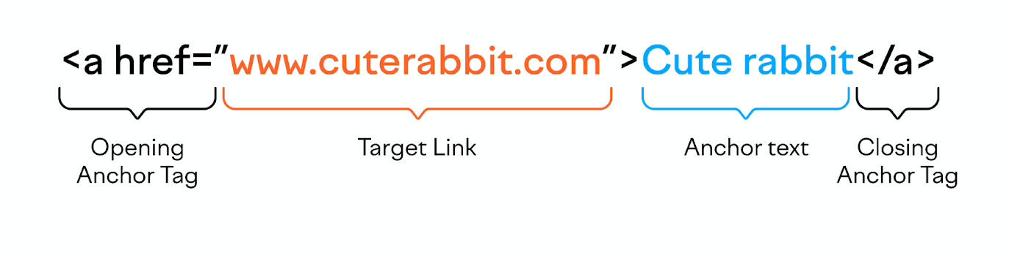
Link tags
The <a> tag defines a hyperlink, which is used to link from one page to another.
The most important attribute of the <a> element is the href attribute, which indicates the link's destination.
By default, links will appear as follows in all browsers:
An unvisited link is underlined and blue
A visited link is underlined and purple
An active link is underlined and red

Slide 12
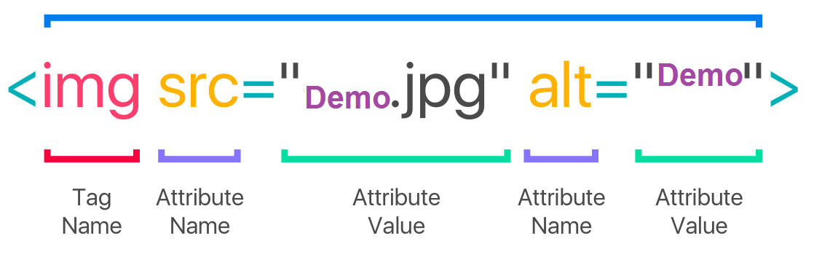
Image tag
The <img> tag is used to embed an image in an HTML page.
Images are not technically inserted into a web page; images are linked to web pages. The <img> tag creates a holding space for the referenced image.
The <img> tag has two required attributes:
src - Specifies the path to the image
alt - Specifies an alternate text for the image, if the image for some reason cannot be displayed

Slide 13
<audio>:
The <audio> tag is used to embed sound content in a document, such as music or other audio streams.
The <audio> tag contains one or more <source> tags with different audio sources. The browser will choose the first source it supports.
The text between the <audio> and </audio> tags will only be displayed in browsers that do not support the <audio> element.
There are three supported audio formats in HTML: MP3, WAV, and OGG.
<audio controls>
<source src="Audio/formula-1-racing-28761.mp3" type="audio/mp3">
</audio>

Slide 14
<video>:
The <video> tag is used to embed video content in a document, such as a movie clip or other video streams.
The <video> tag contains one or more <source> tags with different video sources. The browser will choose the first source it supports.
The text between the <video> and </video> tags will only be displayed in browsers that do not support the <video> element.
There are three supported video formats in HTML: MP4, WebM, and OGG.
<video width="230" height="220" controls>
<source src="Video/Sea water.mp4" type="video/mp4">
</video>

Slide 15
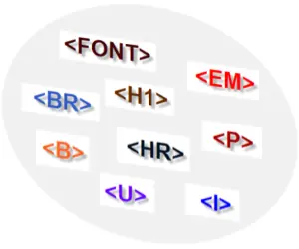
Formatting tags

Slide 16
<p>Well done is <b>better</b> than well said</p>
<p>Well done is better than well said,<del>keep calm</del>and carry on</p>
<p>Well done is better than well said</p>
<p>Well done is better than well said</p> <br /><br />
<p>Well done is better than well said</p>
<p>Well done is better than well said</p>
<p>Well done is better than well said</p>
<hr>
<p>Well done is better than well said</p>
<p>Well done is <strong>better than</strong> well said</p>
<p>Well done is <u>better than</u> well said</p>
<p>Well done is <i>better than</i> well said</p>
<p>Well done is <em>better than</em> well said</p>
<p>Well done is <q>better than</q> well said</p>
<p>Well done is <mark>better than</mark> well said</p>
<p>Well done is <sub>better than</sub> well said</p>
<p>Well done is <sup>better than</sup> well said</p>
<p>Well done is <small>better than</small> well said</p>
<p>Well done is <big>better than</big> well said</p>
<p>Well done is <s>better than</s> well said</p>
<p>The <abbr title="World Health Organization">WHO</abbr> was founded in 1948.</p>
<p style="font-family:'Lucida Console', monospace">This text is monospace text.</p>
<p>Well done is better than well said,<ins>keep calm</ins>and carry on</p>

Slide 17
<b>:
The <b> tag specifies bold text without any extra importance.
<u>:
The <u> tag represents some text that is unarticulated and styled differently from normal text, such as misspelled words or proper names in Chinese text.
The content inside is typically displayed with an underline.
<i>:
The <i> tag defines a part of text in an alternate voice or mood. The content inside is typically displayed in italic.
<strong>:
The <strong> tag is used to define text with strong importance. The content inside is typically displayed in bold.
<del>:
The <del> tag defines text that has been deleted from a document. Browsers will usually strike a line through deleted text.

Slide 18
<em>:
The <em> tag is used to define emphasized text. The content inside is typically displayed in italic.
A screen reader will pronounce the words in <em> with an emphasis, using verbal stress.
<q>:
The <q> tag defines a short quotation.
Browsers normally insert quotation marks around the quotation.
<mark>:
The <mark> tag defines text that should be marked or highlighted.
<sub>:
The <sub> tag defines subscript text. Subscript text appears half a character below the normal line, and is sometimes rendered in a smaller font.
Subscript text can be used for chemical formulas, like H2O.

Slide 19
<sup>:
The <sup> tag defines superscript text. Superscript text appears half a character above the normal line, and is sometimes rendered in a smaller font.
Superscript text can be used for footnotes, like WWW[1].
<small>:
The <small> tag defines smaller text.
<big>:
The <big> tag was used in HTML 4 to define bigger text.
<s>:
The <s> tag specifies text that is no longer correct, accurate or relevant. The text will be displayed with a line through it.
The <s> tag should not be used to define deleted text in a document, use the <del> tag for that.

Slide 20
<abbr>:
The <abbr> tag defines an abbreviation or an acronym, like "HTML", "CSS", "Mr.", "Dr.", "ASAP", "ATM".
<ins>:
The <ins> tag defines a text that has been inserted into a document. Browsers will usually underline inserted text.

Slide 21
<div>:
The <div> tag defines a division or a section in an HTML document.
The <div> tag is used as a container for HTML elements - which is then styled with CSS or manipulated with JavaScript.
The <div> tag is easily styled by using the class or id attribute.
Any sort of content can be put inside the <div> tag!
Note: By default, browsers always place a line break before and after the <div> element.
<div>
<h1>Hellooooo</h1>
<p>This is div</p>
</div>
o/p:
Hellooooo
This is div

Slide 22
<span>:
The <span> tag is an inline container used to mark up a part of a text, or a part of a document.
The <span> tag is easily styled by CSS or manipulated with JavaScript using the class or id attribute.
The <span> tag is much like the <div> element, but <div> is a block-level element and <span> is an inline element.
<p>This is a <span style="color:darkblue">highlighted</span> text</p>

Slide 23
Lists
HTML lists allow web developers to group a set of related items in lists.
Unordered list:
An unordered list starts with the <ul> tag. Each list item starts with the <li> tag.
The list items will be marked with bullets (small black circles) by default:
<ul>
<li>Banana</li>
<li>Apple</li>
<li>Guva</li>
</ul>
o/p:
Banana
Apple
Guva

Slide 24
Ordered lists:
An ordered list starts with the <ol> tag. Each list item starts with the <li> tag.
The list items will be marked with numbers by default:
<ol>
<li>Banana</li>
<li>Apple</li>
<li>Guva</li>
</ol>
o/p:
Banana
Apple
Guva

Slide 25
Description list:
A description list is a list of terms, with a description of each term.
The <dl> tag defines the description list, the <dt> tag defines the term (name), and the <dd> tag describes each term:
<dl>
<dt>Narendra Modi</dt>
<dd>Prime minister</dd>
<dt> Revanth Reddy</dt>
<dd> chief minister</dd>
</dl>
o/p:
Narendra Modi
Prime minister
Revanth Reddy
chief minister

Slide 26
Tables
The <table> tag defines an HTML table.
An HTML table consists of one <table> element and one or more <tr>, <th>, and <td> elements.
The <tr> element defines a table row, the <th> element defines a table header, and the <td> element defines a table cell.
An HTML table may also include <caption>, <colgroup>, <thead>, <tfoot>, and <tbody> elements.
<table>
<tr>
<th>
</tr>
<tr>
<td>
</tr>
</table>

Slide 27
Forms
The <form> tag is used to create an HTML form for user input.
The <form> element can contain one or more of the following form elements:
<input>
<textarea>
<button>
<select>
<option>
<optgroup>
<fieldset>
<label>
<output>

Slide 28
SVG
SVG stands for Scalable Vector Graphics
SVG is used to define vector-based graphics for the Web
SVG defines graphics in XML format
Each element and attribute in SVG files can be animated
SVG is a W3C recommendation
SVG integrates with other standards, such as CSS, DOM, XSL and JavaScript
<svg> Element:
The HTML <svg> element is a container for SVG graphics.
SVG has several methods for drawing paths, rectangles, circles, polygons, text, and much more.

Slide 29

Intuitive design happens when current knowledge Is the same as the target knowledge
-Jared Spool
Web Site Usability: A Designer’s Guide

Slide 30

Summary
HTML documents are basically a tree of nodes, including HTML elements and text nodes.
HTML elements provide the semantics and formatting for documents, including creating paragraphs, lists and tables, and embedding images and form controls.
Each element may have multiple attributes specified

Slide 31

Thank You
Gayathri Appannagari

